Slide 1



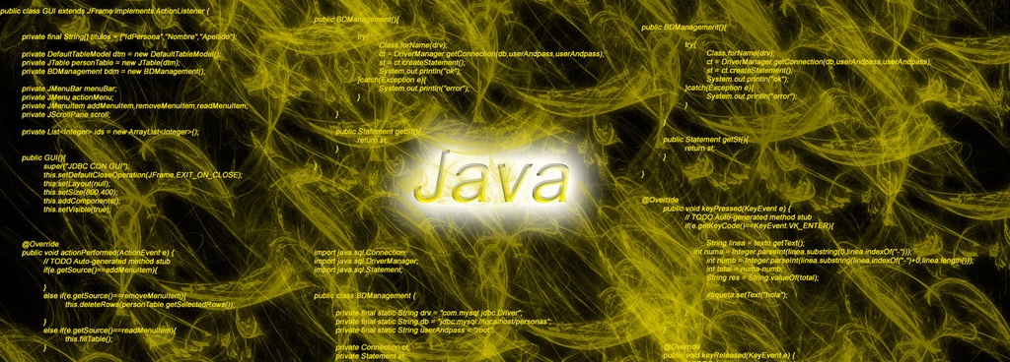
Exception Handling, Reading and Writing in Files, Serialization,
Exceptions, Files, Streams,
File Readers and Writers, Serializable
SoftUni Team
Technical Trainer
Software University
http://softuni.bg

Slide 2

Table of Contents
Exception Handling Basics
Stream types
java.io package
How to choose the correct class?
Readers and Writers
Serialization
Saving custom objects

Slide 3

Exception Handling Basics
Catch and Throw Exceptions

Slide 4

Handling Exceptions
In Java exceptions are handled by the try-catch-finally construction
catch blocks can be used multiple times to process different exception types
try {
// Do some work that can raise an exception
} catch (SomeException ex) {
// Handle the caught exception
} finally {
// This code will always execute
}

Slide 5

Handling Exceptions – Example
public static void main(String[] args) {
String str = new Scanner(System.in).nextLine();
try {
int i = Integer.parseInt(str);
System.out.printf(
"You entered a valid integer number %d.\n", i);
}
catch (NumberFormatException nfex) {
System.out.println("Invalid integer number: " + nfex);
}
}

Slide 6
The "throws …" Declaration
A method in Java could declare "throws SomeException"
This says "I don't care about SomeException", please re-throw it
public static void copyStream(Reader Reader,
Writer Writer) throws IOException {
byte[] buf = new byte[4096]; // 4 KB buffer size
while (true) {
int bytesRead = Reader.read(buf);
if (bytesRead == -1)
break;
Writer.write(buf, 0, bytesRead);
}
}

Slide 7
Resource Management in Java
When we use a resource that is expected to be closed, we use the try-with-resources statement
try(
BufferedReader fileReader = new BufferedReader(
new FileReader("somefile.txt"));
) {
while (true) {
String line = fileReader.readLine();
if (line == null) break;
System.out.println(line);
} catch (IOException ioex) {
System.err.println("Cannot read the file ".);
}

Slide 8

Files
What are Files?

Slide 9

Files
A file is a resource for storing information
Located on a storage device (e.g. hard-drive)
Has name, size, extension and contents
Stores information as series of bytes
Two file types – text and binary

Slide 10

File Class in Java
The Java File class - an abstract representation of file and directory pathnames
Has exists() method that checks if the given path is poitning to a file that exists.
Has isDirectory() method that checks if the given path is pointing to a directory.
File file = new File("hello.txt");
System.out.println("We got a file: " + file);
System.out.println("Does it exists? " + file.exists());
System.out.println("Is a directory? " + file.isDirectory());

Slide 11

Streams
Streams Basic Concepts

Slide 12



What is Stream?
Stream is the natural way to transfer data in the computer world
To read or write a file, we open a stream connected to the file and access the data through the stream
Input stream
Output stream

Slide 13
Streams Basics
Streams are means for transferring (reading and writing) data into and from devices
Streams are ordered sequences of bytes
Provide consecutive access to its elements
Different types of streams are available to access different data sources:
File access, network access, memory streams and others
Streams are opened before using them and closed after that

Slide 14
Stream – Example
Length = 9
Position is the current position in the stream
Buffer keeps the current position + n bytes of the stream
F i l e s a n d
46 | 69 | 6c | 65 | 73 | 20 | 61 | 6e | 64
Position
Buffer
46 | 69
6c | 65
73 | 20
61 | 6e
64

Slide 15
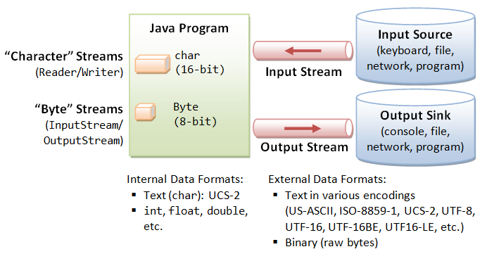
Stream Types in Java
Byte based streams
Subclasses of the abstract classes InputStream and OutputStream
Character based streams
Subclasses of the abstract classes Reader and Writer
The methods for reading and writing data are similar

Slide 16
Stream Types in Java (2)
The InputStream and OutputStream classes read and write 8-bit bytes.
The Writer and Reader classes read and write 16-bit Unicode characters.
Derived classes of the above 4 abstract classes add additional responsibilities using the Decorator pattern.
Pepperoni pizza
t
Veg pizza
Plain pizza

Slide 17

Byte Stream Abstract Classes
InputStream – byte reader
read() a single byte or an array of bytes
skip() bytes
mark() and reset() position
close() the stream
OutputStream – byte writer
write() a single byte or an array of bytes
flush() the stream (in case it is buffered)
close() the stream

Slide 18


Character Stream Abstract Classes
Reader – character reader
read() a single char or into a char array
skip() chars
mark() and reset() position
close() the stream
Writer – character writer
write() a single char or from a char array
flush() the stream (in case it is buffered)
close() the stream

Slide 19
Byte Stream Concrete Classes
FileInputStream, FileOutputStream
BufferedInputStream, BufferedOutputStream
ByteArrayInputStream, ByteArrayOutputStream
DataInputStream, DataOutputStream
FilterInputStream, FilterOutputStream
ObjectInputStream, ObjectOutputStream
PipedInputStream, PipedOutputStream
LineNumberInputStream
PrintStream

Slide 20
Character Stream Concrete Classes
FileReader, FileWriter
BufferedReader, BufferedWriter
CharArrayReader, CharArrayWriter
InputStreamReader, OutputStreamWriter
FilterReader, FilterWriter
ObjectReader, ObjectWriter
PipedReader, PipedWriter
StringReader, StringWriter
LineNumberReader
PrintWriter

Slide 21
Applying the Decorator pattern
Example: Read each line from a file
Wrap an InputStreamReader over an InputStream.
Then, wrap a BufferedReader over the InputStreamReader.
BufferedReader br = new BufferedReader( new InputStreamReader( new FileInputStream(fileName)));
BufferedReader br = new BufferedReader( new InputStreamReader(System.in));

Slide 22
Applying the Decorator pattern (2)
BufferedReader
Reads text from a character input stream.
Buffers characters, providing efficient reading of chars, arrays and lines.
FileInputStream
Obtains input bytes from a file in a file system.
InputStreamReader
Bridge from byte streams to character streams.
It reads and decodes them into characters using a specified charset.

Slide 23
How to choose the correct implementation?
What is your format: text or binary?
Do you want random access to a file?
Are you using objects or non-objects?
What are your sources and sinks of data (like sockets, files, strings…)?
Do you need to use filtering techniques like buffering or checksumming?

Slide 24

Readers and Writers
InputStream, Reader
OutputStream, Writer

Slide 25
Input/OutputStream and Reader/Writer
Readers/Writers and Input/OutputStreams are classes which facilitate the work with streams
Two types
Text readers/writers – Reader / Writer
Provide methods .read(), .write()
Binary readers/writers – InputStream/ OutputStream
Provide methods for working with binary data

Slide 26
Buffered Input/Output
Provides a buffer for the data in order to provide more efficient way of reading/writing.
BufferedReader bfr = BufferedReader(
new FileReader(
"resources/character_streams/input"));
String s;
while ((s = bfr.readLine()) != null) {
System.out.println(s);
}

Slide 27
Data streams
Support binary I/O of primitive data type values (boolean, char, byte, short, int, long, float, and double) as well as String values
DataOutputStream dos = new DataOutputStream(
new BufferedOutputStream(
new FileOutputStream(
"resources/data_streams/data.save")))
dos.writeInt(age);
dos.writeDouble(money);
dos.writeUTF(name);
DataInputStream dis = new DataInputStream(
new BufferedInputStream(
new FileInputStream(
"resources/data_streams/data.save")))) {
System.out.println("Age: " + dis.readInt());
System.out.println("Money: " + dis.readDouble());
System.out.println("Name: " + dis.readUTF());

Slide 28
Object streams
Support I/O of objects.
HashMap<String, Double> grades = new HashMap<>();
grades.put("Pesho", 5.5);
grades.put("Gosho", 3.2);
grades.put("Penka", 4.75);
ObjectOutputStream oos = new ObjectOutputStream(
new BufferedOutputStream(
new FileOutputStream(
"resources/object_streams/object.save")))
oos.writeObject(grades);
ObjectInputStream ois = new ObjectInputStream(
new BufferedInputStream(
new FileInputStream(
"resources/object_streams/object.save")))
System.out.println("Grades: " + ois.readObject());

Slide 29
Saving Custom Objects
In order to save custom objects your class should implement Serializable interface
public class Person implements Serializable{
private String name;
private int age;
…
}
static class Main(String[] args) {
Person pesho = new Person("Pesho", 17);
ObjectOutputStream oos = new ObjectOutputStream(
new BufferedOutputStream(
new FileOutputStream(
"resources/object_streams/object.save")))
oos.writeObject(pesho);
}

Slide 30

Summary
Java supports classical exception handling
Through the try-catch-finally construct
Streams are ordered sequences of bytes
Serve as I/O mechanisms
Can be read or written to (or both)
Can have any nature – file, network, memory,
device, etc.
Serialization enables custom objects to be transferred via different streams

Slide 31










Java Basics – Loops, Methods, Classes
https://softuni.bg/courses/java-basics/

Slide 32
License
This course (slides, examples, demos, videos, homework, etc.) is licensed under the "Creative Commons Attribution-NonCommercial-ShareAlike 4.0 International" license
Attribution: this work may contain portions from
"Fundamentals of Computer Programming with Java" book by Svetlin Nakov & Co. under CC-BY-SA license
"C# Basics" course by Software University under CC-BY-NC-SA license

Slide 33





Free Trainings @ Software University
Software University Foundation – softuni.org
Software University – High-Quality Education, Profession and Job for Software Developers
softuni.bg
Software University @ Facebook
facebook.com/SoftwareUniversity
Software University @ YouTube
youtube.com/SoftwareUniversity
Software University Forums – forum.softuni.bg

